Slide 1
Yorkshire Attractions Survey Visitsunlimited
Survey of 50 attraction based in the region.
Research conducted to gauge opinions of attractions on
the issue of ‘access’ for disabled children and their
families.

Slide 2
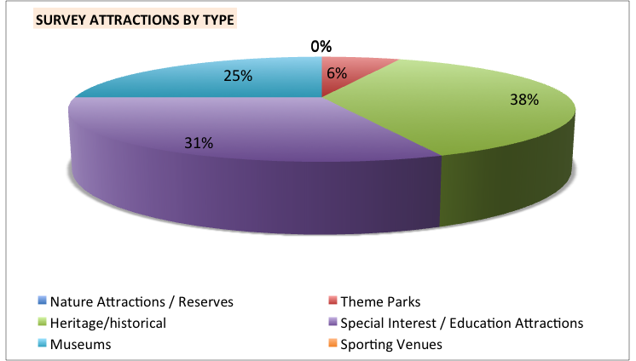

Slide 3
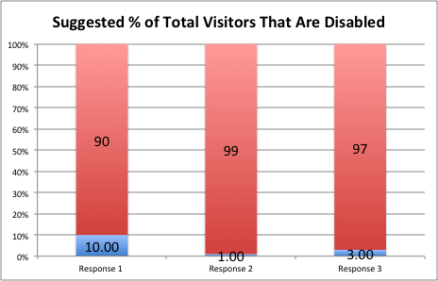
Do you attract families with disabled children?
Question.
What % of the total number
of visitors would you suggest
are disabled children?
Responses from 1% to 10% with many not aware of footfall to their attraction.

Slide 5
Question.
Have you received training in
understanding the visitor experience
for families with disabled children?

Slide 6
Question.
Do you currently have any marketing in place
to attract families with disabled children?
Marketing to disabled children brings increased footfall from
family members, personal assistants and wider family and friends,
increasing footfall and spend.

Slide 7
Challenges
50% stated physical barriers hindered attracting disabled visitors
No attractions stated there were staffing challenges in meeting the needs of disabled visitors
25% stated there were budgetary restrictions in developing their offer for families with disabled children
56% stated they had budget for business development
75% stated they had budget for staff development

Slide 8
Attraction Aspirations
All attractions responded stating they wished for increased footfall
All respondents appreciated the benefit of marketing their attraction as disabled family friendly
88% stated they wished to maximise additional marketing opportunities
75% wished for further advice and training in improving their offer for families with disabled children
69% wished to improve skill set in improving the visitor experience for disabled visitors – higher on the priority list of families with disabled children than physical access provision.

Slide 9
Conclusions from Research
All attractions want to increase footfall and revenue
All appreciated the benefit of marketing to families with disabled children
There is a misconception that access is predominantly related to physical access around a venue with less emphasis on appropriate information and staff training
Most venues desired more skills and opportunities to serve this market, including support with marketing their attraction
Budget restriction was an adverse factor but in only a minority of cases
Individual site managers of the large heritage organisations are concerned over the restrictions in marketing the unique aspects of their attraction because of central control of marketing services including website management

